Slide 1
Chapter 2
Layout Management

Slide 2
Content
Arranging several labels within a label frame Widget
Using padding to add space around widgets
Dynamically expanding the GUI using widgets
Aligning GUI widgets by embedding frames within frames
Creating menu bars
Creating tabbed widgets
Using the grid layout manager
[ 2 ]

Slide 3
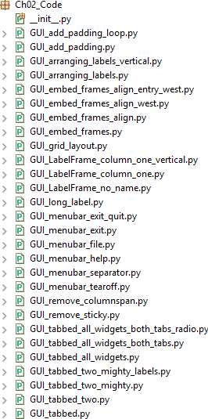
Layout Management Chapter 2
The following screenshot provides an overview of the Python modules that will be used in this chapter:

Slide 4
Arraning several labels within a label frame widget
The LabelFrame widget allows us to design our GUI in an organized fashion. We are still using the grid layout manager as our main layout design tool, but by using LabelFrame widgets, we get much more control over our GUI's design.
Layout Management Chapter 2

Slide 5
Layout Management Chapter 2
Getting ready
We will start by adding more widgets to our GUI. We will make the GUI fully functional in upcoming recipes.
Here, we will start to use the LabelFrame widget. We will reuse the GUI from the Adding several widgets to a loop recipe in Chapter 1, Creating the GUI Form and Adding Widgets.

Slide 6
Layout Management Chapter 2
How to do it…
Open GUI_adding_widgets_in_loop.py from Chapter 1, Creating the GUI Form and Adding Widgets, and save the module as GUI_LabelFrame_column_one.py.
Create a ttk.LabelFrame and position it in the grid:
buttons_frame = ttk.LabelFrame(win,text= 'Labels in a Frame') buttons_frame.grid(column=0, row=7)
# button_frame.grid(column=1, row=7)

Slide 7
Layout Management Chapter 2
How to do it…
Create three ttk Labels, set their text attributes, and position them in the grid:
ttk.Label(buttons_frame, text="Label1").grid(column=0, row=0, sticky=tk.W)
ttk.Label(buttons_frame, text="Label2").grid(column=1, row=0, sticky=tk.W)
ttk.Label(buttons_frame, text="Label3").grid(column=2, row=0, sticky=tk.W)

Slide 8
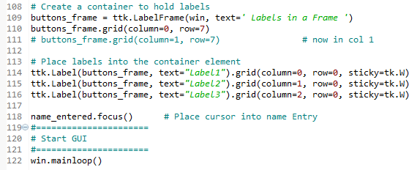
Layout Management
Chapter 2
The preceding instructions produce the following code from the GUI_LabelFrame_column_one.py file:

Slide 9
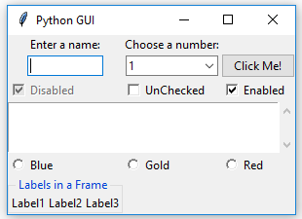
Layout Management
Chapter 2
4. Run the code. It will result in the following GUI:

Slide 10
Layout Management Chapter 2
In addition, we can easily align the labels vertically by changing our code. To do this perform the following steps:
Open GUI_LabelFrame_column_one.py and save the module as
GUI_LabelFrame_column_one_vertical.py.
Change the column and row values, as follows:
ttk.Label(button_frame, text="Label1").grid(column=0,row=0) ttk.Label(button_frame, text="Label2").grid(column=0,row=1) ttk.Label(button_frame, text="Label3").grid(column=0,row=2)

Slide 11
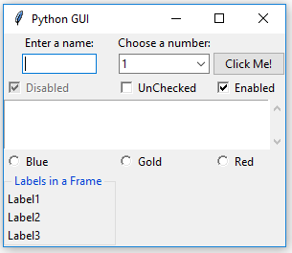
Layout Management Chapter 2
3. Run the GUI_LabelFrame_column_one_vertical.py file. Now the GUI label frame will look as follows:

Slide 12
Layout Management Chapter 2
Using padding to add space around widgets
We will improve the visual aspects of our widgets by adding a little space around them so that they can breathe.

Slide 13
Layout Management Chapter 2
Getting ready
While tkinter might have had a reputation for creating not-so-pretty GUIs, this has dramatically changed since version 8.5.
tkinter version 8.6 ships with Python 3.7. There's no need to install anything other than Python in order to use it.
A simple way of adding spacing around widgets will be shown first, and then we will use a loop to achieve the same thing in a much better way.
Our LabelFrame looks a bit tight as it blends into the main window toward the bottom.

Slide 14
Layout Management Chapter 2
How to do it…
Follow these steps to add padding around the widgets:
Open GUI_LabelFrame_column_one.py and save it as GUI_add_padding.py.
Add padx and pady to the grid method:
buttons_frame.grid(column=0, row=7, padx=20, pady=40) # padx, pady

Slide 15
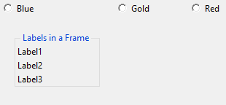
Layout Management Chapter 2
3.Run the code. Now our LabelFrame has some breathing space. We can see this in the following screenshot:

Slide 16
Layout Management Chapter 2
We can use a loop to add space around the labels contained within LabelFrame. Follow these steps to do so:
Open GUI_add_padding.py and save it as GUI_add_padding_loop.py.
Add the following loop below the creation of the three Labels:
for child in buttons_frame.winfo_children(): child.grid_configure(padx=8, pady=4)

Slide 17
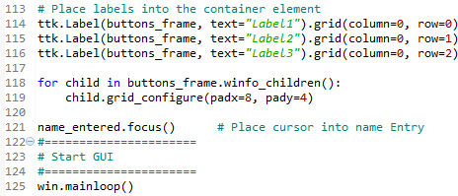
Layout Management Chapter 2
The preceding instructions produce the following code:

Slide 18
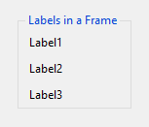
Layout Management Chapter 2
3. Run the GUI_add_padding_loop.py file code. Now the labels within the LabelFrame widget have some space around them too:

Slide 19
Layout Management Chapter 2
To see this effect better, let's do the following:
Open GUI_add_padding_loop.py and save it as GUI_long_label.py.
Change the text of Label1, like so:
ttk.Label(buttons_frame, text="Label1 – so much longer...").grid(column=0, row=0)

Slide 20
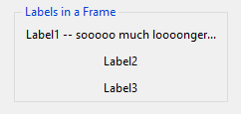
Layout Management Chapter 2
To see this effect better, let's do the following:
Run the code. This will generate what's shown in the following screenshot, which shows our GUI. Note how there is now space to the right of the long label, next to the dots. The last dot doesn't touch LabelFrame, which it otherwise would have without the added space:

Slide 21
Layout Management Chapter 2
We can also remove the LabelFrame name to see the effect padx has on the position of our labels. Let's get started:
Open GUI_add_padding_loop.py and save it as
GUI_LabelFrame_no_name.py.
When creating the button, set the text attribute to an empty string:
buttons_frame = ttk.LabelFrame(win, text='')

Slide 22
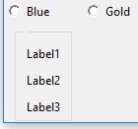
Layout Management Chapter 2
Run the code. By setting the text attribute to an empty string, we remove the name that was previously displayed for LabelFrame. This can be seen in the following screenshot:

Slide 23
Layout Management Chapter 2
Dynamically expanding the GUI using widgets
You may have noticed from the previous screenshots and by running the preceding code that the widgets can extend themselves to take up as much space as they need in order to visually display their text.
Using tkinter, this dynamic capability creates both an advantage and a little bit of a challenge because, sometimes, our GUI dynamically expands when we would like it not to be so dynamic! Well, we are dynamic Python programmers, so we can figure out how to make the best use of this fantastic behavior!

Slide 24
Layout Management Chapter 2
Getting ready
At the beginning of the previous recipe, Using padding to add space around widgets, we added a LabelFrame widget. This moved some of our controls to the center of column 0. We might not want this modification in our GUI layout.
We will explore some ways to solve this in this recipe.

Slide 25
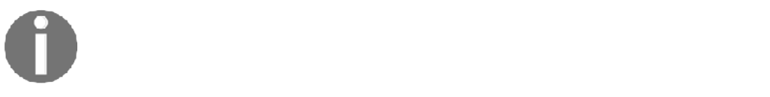
Layout Management Chapter 2
The following is an example of a grid layout manager with two rows and three columns:
Row 0; Col 0 | Row 0; Col 1 | Row 0; Col 2
Row 1; Col 0 | Row 1; Col 1 | Row 1; Col 2
Using the grid layout manager, the width of any given column is determined by the longest name or widget in that column. This, in turn, affects all of the rows.

Slide 26
Layout Management Chapter 2
By adding our LabelFrame widget and giving it a title that is longer than a hard-coded size widget, we dynamically move those widgets to the center of column 0. By doing so, we are adding space on the left- and right-hand side of those widgets.
Incidentally, because we used the sticky property for the Checkbutton and ScrolledText
widgets, those remain attached to the left-hand side of the frame.

Slide 27
Layout Management Chapter 2
Let's take a look at the screenshot from the first recipe in this chapter, Arranging several labels within a label frame widget, in more detail.
Since the text property of LabelFrame, which is displayed as the title of LabelFrame, is longer than both our Enter a name: label and the text box entry below it, those two widgets are dynamically centered within the new width of column 0, as shown in the following screenshot:

Slide 28
Layout Management Chapter 2
Notice how both the label and the entry below it are no longer positioned on the left but have been moved to the center within the grid column.
We added the following code to GUI_LabelFrame_no_name.py to create a LabelFrame and then placed labels in this frame to stretch both the Label frame and the widgets contained therein:
buttons_frame = ttk.LabelFrame(win, text='Labels in a Frame') buttons_frame.grid(column=0, row=7)

Slide 29
Layout Management Chapter 2
The Checkbutton and Radiobutton widgets in column 0 did not get centered because we used the sticky=tk.W attribute when we created those widgets.
For the ScrolledText widget, we also used sticky=tk.WE, which binds the widget to both the west (the left) and east (the right) side of the frame.

Slide 30
Layout Management Chapter 2
How to do it…
Perform the following steps to complete this recipe:
Open GUI_arranging_labels.py and save it as GUI_remove_sticky.py.
Remove the sticky attribute from the ScrolledText widget and observe the effect this change has.

Slide 31
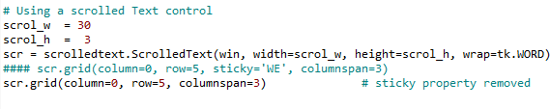
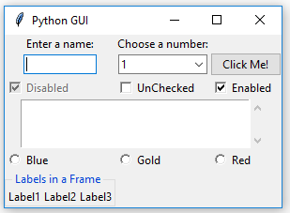
Layout Management Chapter 2
3. Run the code. Now our GUI has a new space around the ScrolledText widget, both on the left- and right-hand sides. Because we used the columnspan=3 property, our ScrolledText widget still spans all three columns. This is shown in the following screenshot:

Slide 32
Layout Management Chapter 2
Using columnspan is necessary to arrange our GUI in the way we desire it to look.
Let's take a look at how not using the columnspan attribute could screw up our nice GUI design by doing the following modifications:
Open GUI_remove_sticky.py and save it as GUI_remove_columnspan.py.
If we remove columnspan=3, we'll get the GUI that's shown in the following screenshot, which is not what we want. Now ScrolledText only occupies column 0 and, because of its size, stretches the layout.

Slide 33
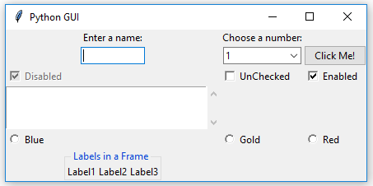
Layout Management
Chapter 2
3. Run the GUI_remove_columnspan.py file and observe the output:

Slide 34
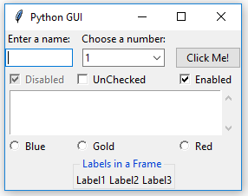
Layout Management
Chapter 2
One way to get our layout back to where it was before adding LabelFrame is to adjust the grid column position. Let's get started:
Open GUI_remove_columnspan.py and save it as
GUI_LabelFrame_column_one.py.
Change the column value from 0 to 1:
buttons_frame.grid(column=1, row=7)
Run the code. Now our GUI will look as follows:

Slide 35
Layout Management Chapter 2
Aligning GUI widgets by embedding frames within frames
We'll have better control of our GUI layout if we embed frames within frames. This is what we will do in this recipe.
Getting ready
We will continue using the GUI we created in the previous recipe, Dynamically expanding the GUI using widgets.

Slide 36
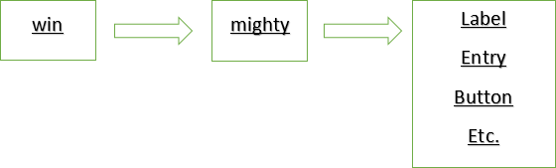
Layout Management Chapter 2
Creates the following hierarchy in our GUI layout:

Slide 37
Layout Management Chapter 2
How to do it…
Perform the following steps to complete this recipe:
Open GUI_LabelFrame_column_one.py and save it as
GUI_embed_frames.py.
Add the following code toward the top of our Python module:
mighty = ttk.LabelFrame(win, text=' Mighty Python ') mighty.grid(column=0, row=0, padx=8, pady=4)
Next, we will modify the following controls to use mighty as the parent, replacing win.

Slide 38
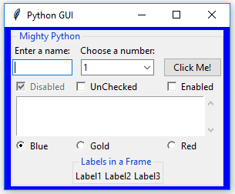
Layout Management
Chapter 2
Change the Label parent from win to mighty:
a_label = ttk.Label(mighty, text="Enter a name:") a_label.grid(column=0, row=0)
Run the GUI_embed_frames.py file. This results in the GUI shown in the following screenshot:

Slide 39
Layout Management
Chapter 2
Note how all the widgets are now contained in the Mighty Python LabelFrame, which surrounds all of them with a barely visible thin line. Next, we can reset the Labels in a Frame widget to the left without messing up our GUI layout:
Open GUI_embed_frames.py and save it as GUI_embed_frames_align.py.
Change column to 0:
buttons_frame = ttk.LabelFrame(mighty, text=' Labels in a Frame ') buttons_frame.grid(column=0, row=7)

Slide 40
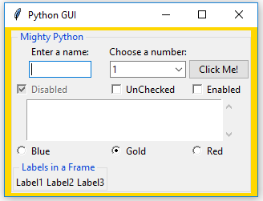
Layout Management
Chapter 2
Run the GUI_embed_frames_align.py file. This results in the GUI shown in the following screenshot:

Slide 41
Layout Management
Chapter 2
To align them to the left, we have to force our GUI layout by using the sticky property. By assigning it 'W' (west), we can force the widget to be left-aligned. Perform the following steps:
Open GUI_embed_frames_align.py and save it as
GUI_embed_frames_align_west.py.
Add the sticky attribute to the label:
a_label = ttk.Label(mighty, text="Enter a name:") a_label.grid(column=0, row=0, sticky='W')

Slide 42
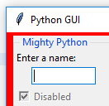
Layout Management
Chapter 2
To align them to the left, we have to force our GUI layout by using the sticky property. By assigning it 'W' (west), we can force the widget to be left-aligned. Perform the following steps:
Run the code. This gives us the following GUI:

Slide 43
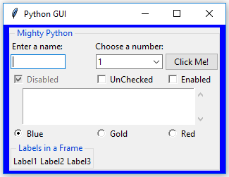
Layout Management
Chapter 2
Let's align the Entry widget in column 0 to the left:
Open GUI_embed_frames_align_west.py and save it as
GUI_embed_frames_align_entry_west.py.
Use the sticky attribute to align the Entry left:
#

Slide 44
Layout Management
Chapter 2
3. Run the GUI_embed_frames_align_entry_west.py file. Now both the label and the entry are aligned toward the west (left):
#

Slide 45
Layout Management Chapter 2
Creating menu bars
In this recipe, we will add a menu bar to our main window, add menus to the menu bar, and then add menu items to the menus.
Getting ready
We will start by learning how to add a menu bar, several menus, and a few menu items. In the beginning, clicking on a menu item will have no effect. We will add functionality to the menu items later, for example, closing the main window when clicking the Exit menu item and displaying a Help | About dialog.
We will continue to extend the GUI we created in the previous recipe, Aligning GUI widgets by embedding frames within frames.

Slide 46
Layout Management
Chapter 2
How to do it…
To create a menu bar, follow these steps:
Open GUI_embed_frames_align_entry_west.py and save it as
GUI_menubar_file.py.
Import the Menu class from tkinter:
import tkinter as tk
from tkinter import ttk
from tkinter import scrolledtext from tkinter import Menu

Slide 47
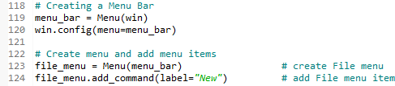
Layout Management
Chapter 2
How to do it…
Next, we will create the menu bar. Add the following code toward the bottom of the module, just above where we created the main event loop:
# Creating a Menu Bar
menu_bar = Menu(win) win.config(menu=menu_bar)
# Create menu and add menu items
file_menu = Menu(menu_bar) # create File menu file_menu.add_command(label="New") # add File menu item

Slide 48
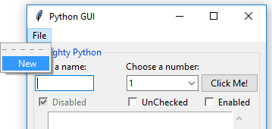
Layout Management Chapter 2
To make this work, we also have to add the menu to the menu bar and give it a label.
The menu item was already added to the menu, but we still have to add the menu to the menu bar:
menu_bar.add_cascade(label="File", menu=file_menu)
# add File menu to menu bar and give it a label
Running the preceding code adds a menu bar with a menu that has a menu item. This is shown in the following screenshot:

Slide 49
Layout Management Chapter 2
Next, we'll add a second menu item to the first menu that we added to the menu bar. This can be done by performing the following steps:
Open GUI_menubar_file.py and save it as GUI_menubar_exit.py.
Add the Exit menu item:
file_menu.add_command(label="Exit")

Slide 50
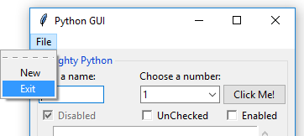
Layout Management
Chapter 2
3. Running the preceding code produces the following result, that is, GUI_menubar_exit.py:

Slide 51
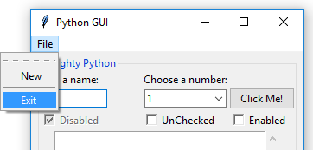
Layout Management
Chapter 2
We can add separator lines between the menu items by adding a line of code in-between the existing menu items. This can be done by performing the following steps:
Open GUI_menubar_exit.py and save it as GUI_menubar_separator.py.
Add a separator, as follows:
file_menu.add_separator()
Run the preceding code. In the following screenshot, we can see that a separator line has been added in-between our two menu items:

Slide 52
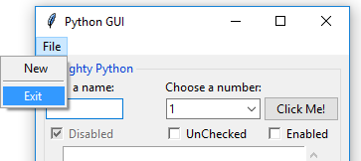
Layout Management Chapter 2
By passing in the tearoff property to the constructor of the menu, we can remove the first dashed line that, by default, appears above the first menu item in a menu. This can be done by performing the following steps:
Open GUI_menubar_separator.py and save it as GUI_menubar_tearoff.py.
Set the tearoff attribute to 0:
file_menu = Menu(menu_bar, tearoff=0)
Run the preceding code. In the following screenshot, the dashed line no longer appears, and our GUI looks so much better:

Slide 53
Layout Management Chapter 2
Next, we'll add a second menu, Help, which will be placed horizontally, to the right of the first menu. We'll give it one menu item, named About, and add this second menu to the menu bar.
File and Help | About are very common Windows GUI layouts we are all familiar with, and we can create these same menus using Python and tkinter:
Open GUI_menubar_tearoff.py and save it as GUI_menubar_help.py.
Add a second menu with a menu item:
help_menu = Menu(menu_bar, tearoff=0) menu_bar.add_cascade(label="Help", menu=help_menu) help_menu.add_command(label="About")

Slide 54
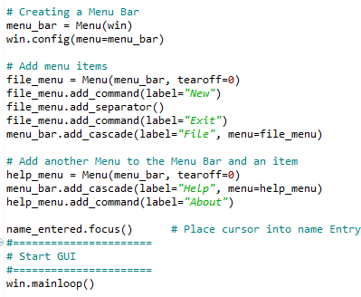
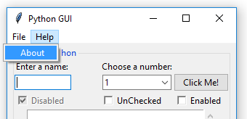
Layout Management Chapter 2
3. Run the preceding code. As shown in the following screenshot, we have a second menu with a menu item in the menu bar:

Slide 55

Layout Management Chapter 2
4. Run the code and click the Exit menu item. The following GUI shows the output of the code we run:

Slide 56
Layout Management Chapter 2
Creating tabbed widgets
In this recipe, we will create tabbed widgets to further organize our expanding GUI written in tkinter.
Getting ready
To improve our Python GUI using tabs, we will start at the beginning, using as little code as possible. In this recipe, we will create a simple GUI and then add widgets from the previous recipes, placing them in this new tabbed layout.
How to do it…
Follow these steps to create Tab controls, which in tkinter are called Notebook:
Create a new Python module and name it GUI_tabbed.py.
At the top of the module, import tkinter:
import tkinter as tk from tkinter import ttk

Slide 57
Layout Management
Chapter 2
Create an instance of the Tk class:
win = tk.Tk()
Add a title via the title attribute:
win.title ("Python GUI")
Create tabControl using the ttk Notebook:
tabControl = ttk.Notebook(win)
Add the tab to tabControl:
tabControl.add(tab1, text-'Tab 1')
Use pack to make the control visible inside the GUI:
The preceding instructions produce the following code, which can be found in the GUI_tabbed.py file:

Slide 58
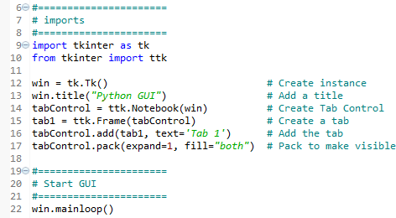

Layout Management
Chapter 2
8. Run the preceding code. The following screenshot shows the GUI after running the code:

Slide 59
Layout Management
Chapter 2
In the preceding code, we pack the tabControl and ttk.Notebook widgets into the main GUI form, expanding the notebook-tabbed control to fill in all the sides. We can add a second tab to our control and click between them by performing the following steps:
Open GUI_tabbed.py and save it as GUI_tabbed_two.py.
Add a second tab:
tab2 = ttk.Frame(tabControl)
# Add a second tab tabControl.add(tab2, text='Tab 2')
# Add second tab

Slide 60

Layout Management
Chapter 2
Run the preceding code. In the following screenshot, we have two tabs. Click on Tab 2 to give it focus:

Slide 61
Layout Management
Chapter 2
After adding a second label plus some spacing around them, we stretch the layout enough so we can see our GUI title again:
Open GUI_tabbed_two_mighty.py and save it as
GUI_tabbed_two_mighty_labels.py.
Add a second label and spacing via a loop:
# Add another label
ttk.Label(mighty, text="Choose a number:").grid(column=1, row=0)
# Add some space around each label for child in mighty.winfo_children():
child.grid_configure(padx=8)

Slide 62
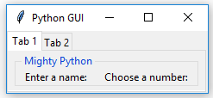
Layout Management
Chapter 2
Run the preceding code. The following screenshot shows the output from running this code, which can also be found in the GUI_tabbed_two_mighty_labels.py file:

Slide 63
Layout Management
Chapter 2
As you can see, all the widgets reside inside Tab 1. Let's move some of them to Tab 2:
1. Create a second LabelFrame, which will be the container of the widgets we will be relocating to Tab 2:
mighty2 = ttk.LabelFrame(tab2, text=' The Snake ')
mighty2.grid(column=0, row=0, padx=8, pady=4)

Slide 64
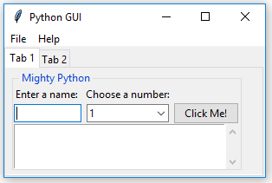
Layout Management Chapter 2
Next, we move the Check and Radio buttons to Tab 2 by specifying the new parent container, which is a new variable that we name mighty2. The following is an example that we will apply to all the controls that relocate to Tab 2:

Slide 65
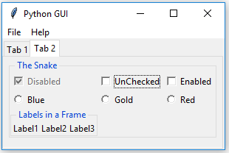
Layout Management Chapter 2
Run the GUI_tabbed_all_widgets_both_tabs.py file. The following screenshot shows the output we receive after running the preceding code:
We can now click on Tab 2 and see our relocated widgets:

Slide 66
Layout Management Chapter 2
After running the preceding code, our GUI looks different. Tab 1 has fewer widgets than it had before when it contained all of our previously created widgets.
Clicking the relocated Radiobutton no longer has any effect, so we will change their actions to renaming the text attribute, from the title of the LabelFrame widget to the name the Radiobuttons display. When we click the Gold Radiobutton, we no longer set the background of the frame to the color gold. Instead, we replace the LabelFrame text title. Python's The Snake now becomes Gold:
Def radCall():
radSel=radVar.get()
if radSel == 0:
mighty2.configure(text ='Blue')
if radSel == 1:
mighty2.configure(text ='Gold')
if radSel == 0:
mighty2.configure(text ='Red')

Slide 67
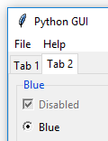
Layout Management Chapter 2
Now selecting any of the RadioButton widgets will change the name of the
LabelFrame.
Run the GUI_tabbed_all_widgets_both_tabs_radio.py file. The following screenshot shows the output of running the code in this file:

Slide 68
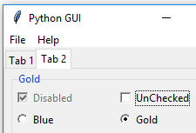
Layout Management Chapter 2
Notice how the label frame is now titled Blue. Clicking on the Gold radio button changes this title to Gold, as shown in the following screenshot:

Slide 69
Using the grid layout manager
Layout Management Chapter 2
The grid layout manager is one of the most useful layout tools at our disposal. While layout tools such as pack are simple and easy to use, grid gives us a lot of control over our layout
especially when we combine grid with embedded frames.
We have already used it in many recipes, for example, because it is just so powerful.
Getting ready…
In this recipe, we will review some grid layout manager techniques. We have already used them, but we will explore them in more detail here.

Slide 70
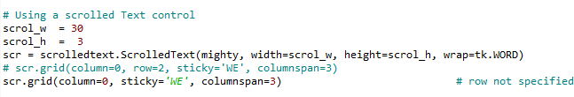
Layout Management Chapter 2
How to do it…
In this chapter, we have created rows and columns, which is the database approach to GUI design (MS Excel does the same). We hard-coded the first rows. However, if we forget to specify where we went the next row to reside, tkinter fills this in without us even noticing.
To observe this, let's take the code from a recipe we previously worked on:
Open GUI_tabbed_all_widgets_both_tabs_radio.py.
Comment out the scr.grid line, as follows:

Slide 71
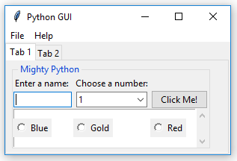
Layout Management Chapter 2
3. Run the code and notice how our radio buttons suddenly ended up in the middle of the Text widget!

Slide 72
Layout Management
Chapter 2
We also used the columnspan property to make sure our widgets did not get limited to just one column, as shown in the following screenshot:

